Slide 1

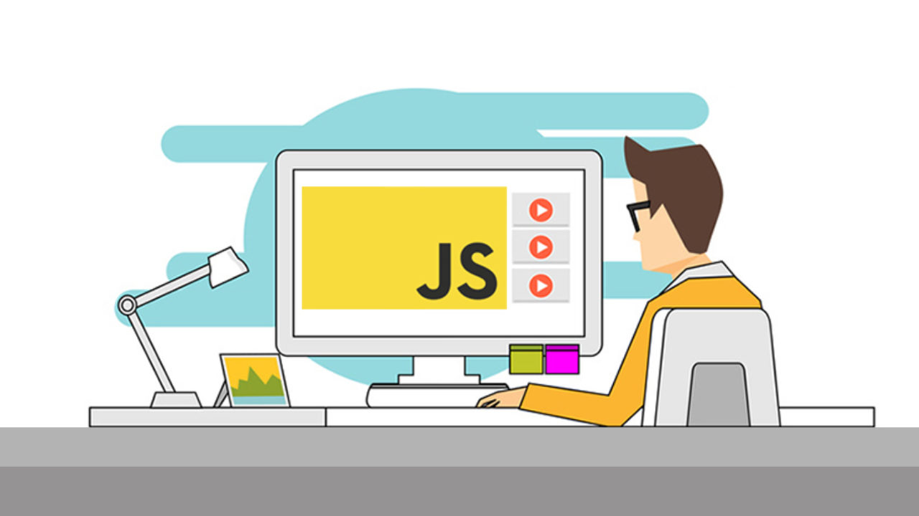
Introduction to Javascript
By: Aditya Raj Singh ⚡

Slide 2



Speaker
Aditya Raj Singh
Full Stack Developer || Tech Enthusiast || Mentor @Codeasylums
@adityarajsingh_ @AdityRajSingh

Slide 3
Why to Learn Javascript?

Slide 4

The key advantages of learning Javascript
⚡Javascript is the most popular programming language in the world and that makes it a programmer’s great choice.
⚡ Javascript is everywhere, it comes installed on every modern web browser and so to learn Javascript you really do not need any special environment setup.
⚡ JavaScript usage has now extended to mobile app development, desktop app development, and game development.
⚡ Due to high demand, there is tons of job growth and high pay for those who know JavaScript.

Slide 5
What is Javascript?

Slide 6
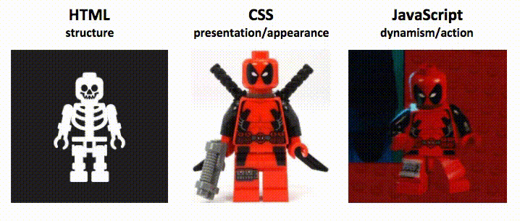
HTML Vs CSS Vs Javascript

Slide 7
What is Javascript?
⚡JavaScript is a simple scripting language invented specifically for use in web browsers to make websites more dynamic.
⚡ Adding JavaScript to your code allows you to change how the document looks completely, from changing text, to changing colours, to changing the options available in a drop-down list (and much, much more!).
⚡ JavaScripts are integrated into the browsing environment, which means they can get information about the browser and HTML page, and modify this information, thus changing how things are presented on your screen

Slide 8
History of Javascript?

Slide 9
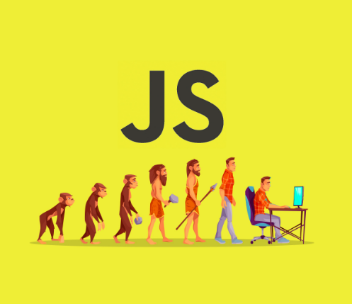
History of Javascript?
⚡Created in 1995 by Brendan Eich First version was created in 10 days! ⚡ Microsoft releases JScript for IE after few months Netscape goes to ECMA for getting standards First formal standards released in 1999 as ECMAScript 3- Has been stable ever since ⚡ Second coming happened after Google popularised concept of AJAX for their web apps. ⚡ Latest version (ES9) released in 2018 with a lot of new features

Slide 10
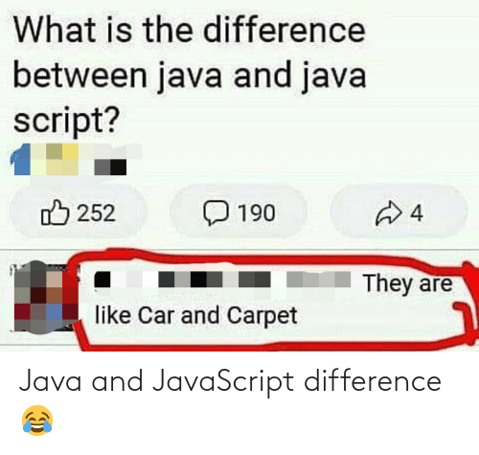
Java vs Javascript
⚡JavaScript is a lightweight programming language(“scripting language”) and used to make web pages interactive.
It can insert dynamic text into HTML. JavaScript is also known as browser’s language.
⚡JavaScript(JS) is not similar or related to Java.
Both the languages have a C like a syntax and are widely used in client-side Web applications, but there are few similarities only.
BACK END
TEXT
Front-End Developer

Slide 11
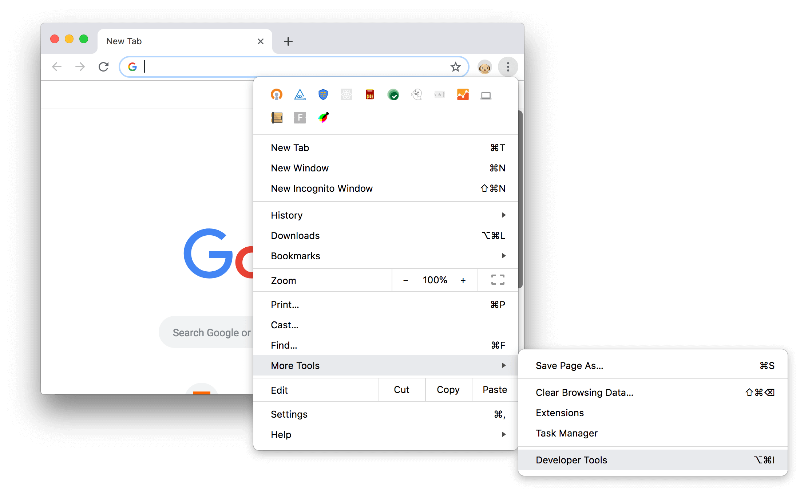
Chrome Developer Tools

Slide 12
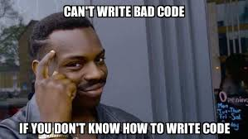
Getting our Hands Dirty in Javascript

Slide 13
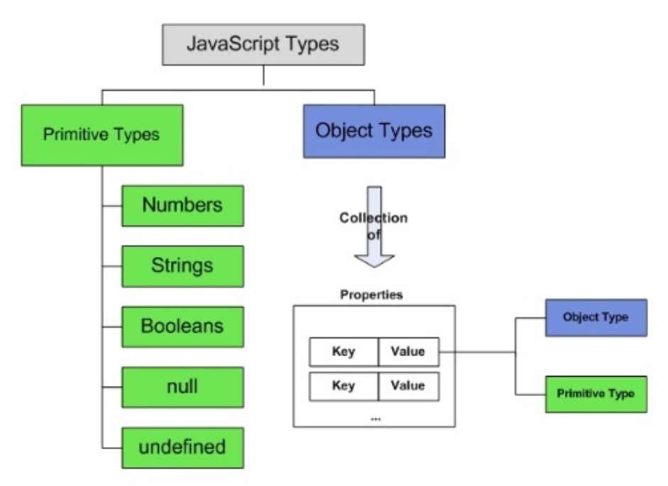
Language Fundamentals
⚡ Primitive Data Types
⚡Number
⚡String
⚡Boolean
⚡null
⚡undefined
⚡Object
⚡Function
⚡Array
⚡Date
⚡RegEx

Slide 14
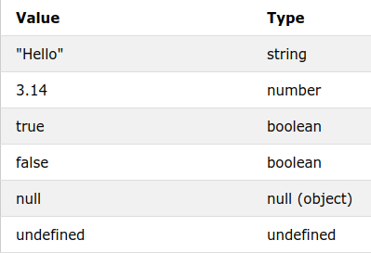
Primitive Data Types
⚡Number
⚡String
⚡Boolean
⚡null
⚡undefined

Slide 15
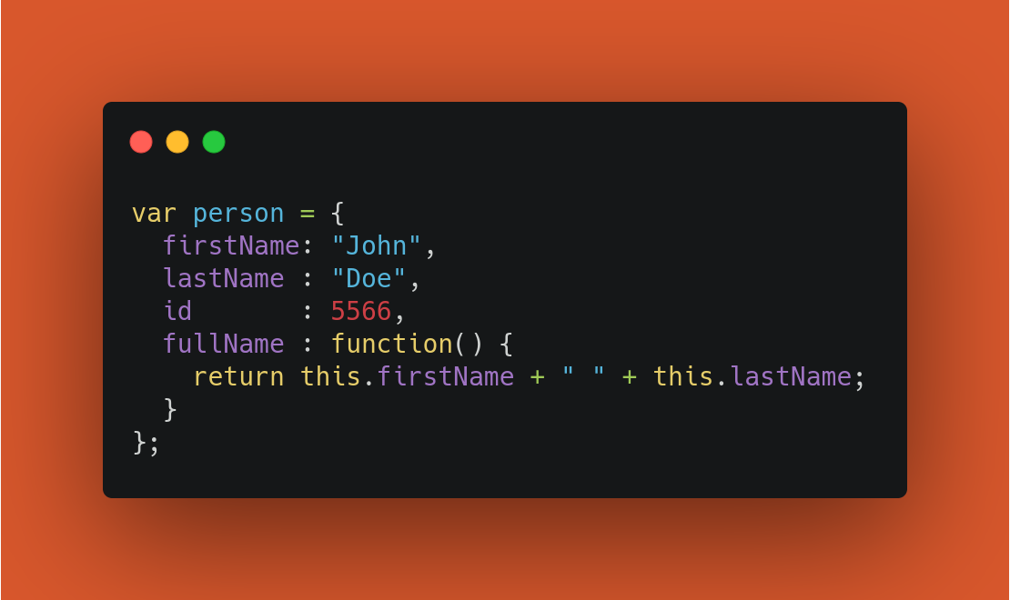
Javascript Objects
⚡ In real life, a car is an object.
A car has properties like weight and color, and methods like start and stop
⚡JavaScript variables are containers for data values. Objects are variables too. But objects can contain many values.
⚡The name:values pairs in JavaScript objects are called properties
⚡Objects can also have methods. Methods are actions that can be performed on objects.

Slide 16
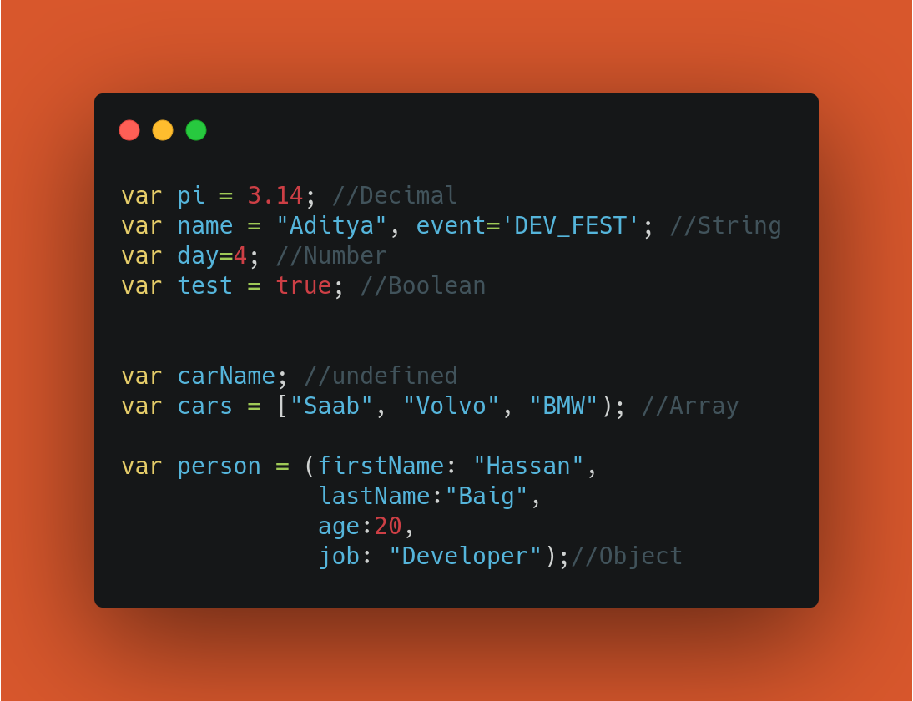
Language Fundamentals

Slide 17
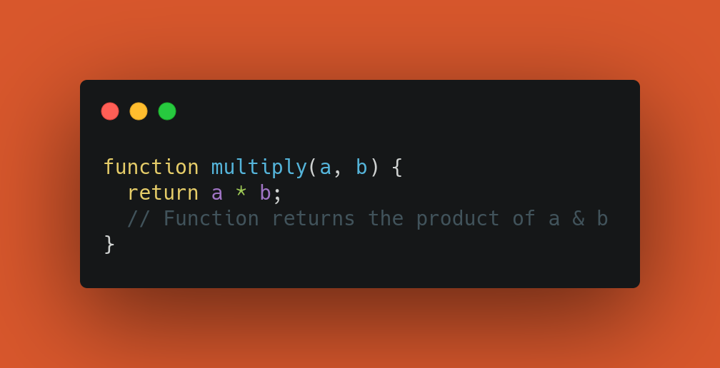
Javascript Functions
⚡ A JavaScript function is a block of code designed to perform a particular task.
⚡A JavaScript function is defined with the function keyword, followed by a name, followed by parentheses ().
⚡The parentheses may include parameter names separated by commas: (parameter1, parameter2, ...)
⚡The code to be executed, by the function, is placed inside curly brackets: {}
⚡When JavaScript reaches a return statement, the function will stop executing.

Slide 18
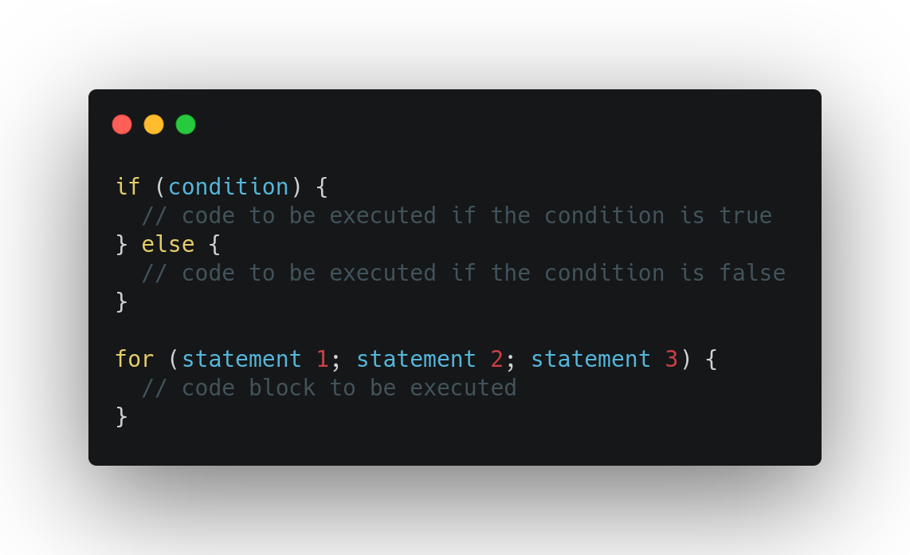
Javascript Conditions and Loops
⚡Conditional Statements:
Very often when you write code, you want to perform different actions for different decisions.
Conditions in JavaScript are "of", "if else", "if else if" and "switch".
⚡JavaScript Loops:
Loops can execute a block of code a number of times.
"Loops in Java Script are "for", "for/in", "while" and "do/while".

Slide 19

Inserting Javascript
⚡ There are two common ways of inserting JavaScript code in a web page:
⚡Adding JavaScript into an HTML Document
⚡In an external file

Slide 20
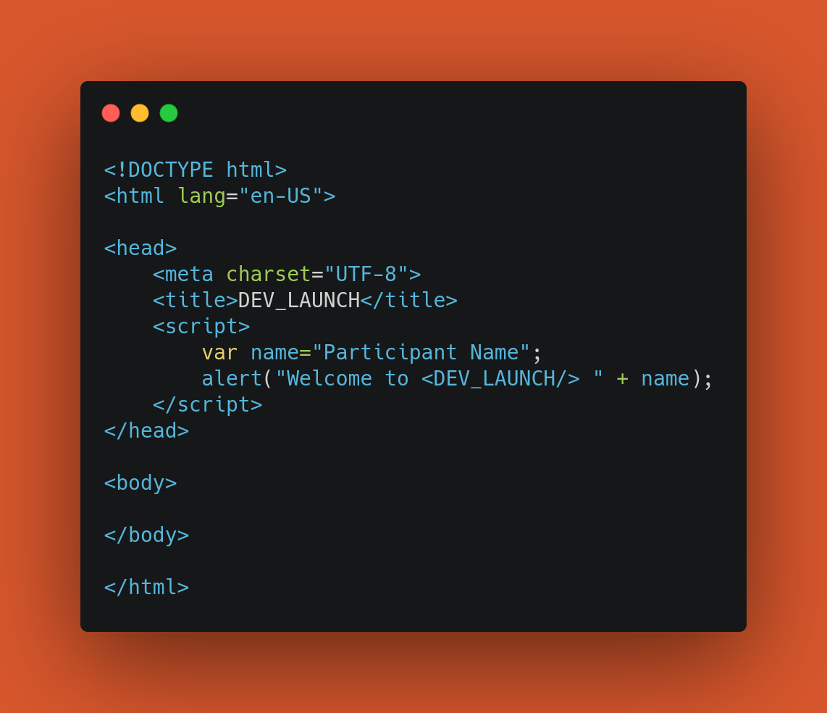
Adding JavaScript into an HTML Document
⚡You can add JavaScript code in an HTML document by employing the dedicated HTML tag <script> that wraps around JavaScript code.
⚡The <script> tag can be placed in the <head> section of your HTML, in the <body> section, or after the </body> close tag, depending on when you want the JavaScript to load.
⚡Generally, JavaScript code can go inside of the document <head> section in order to keep them contained and out of the main content of your HTML document.

Slide 21
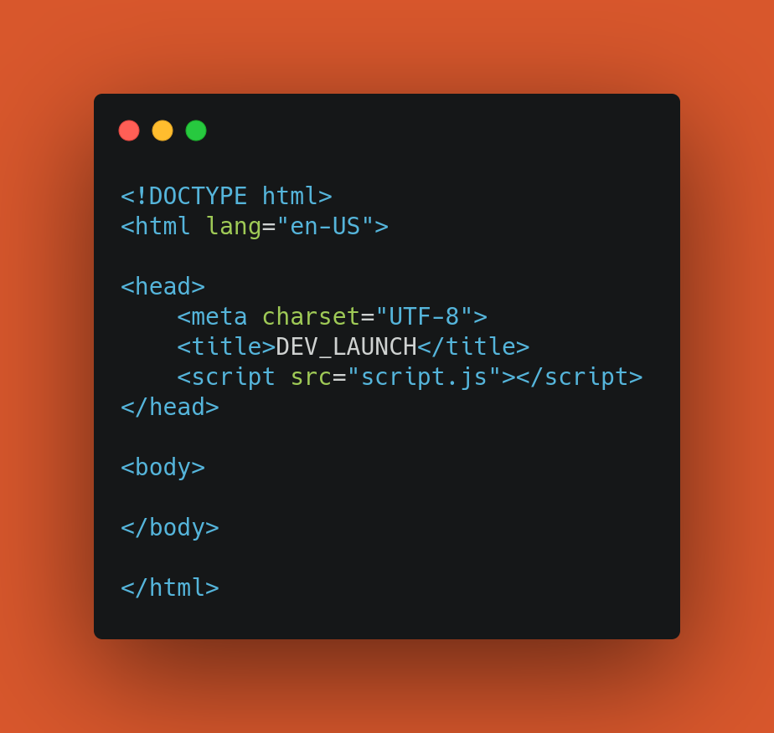
Working with a Separate JavaScript File
⚡In order to accommodate larger scripts or scripts that will be used across several pages, JavaScript code generally lives in one or more js files
⚡The benefits of using a separate JavaScript file include:
⚡Separating the HTML markup and JavaScript code
⚡Separate files makes maintenance easier
⚡When JavaScript files are cached, pages load more quickly

Slide 22
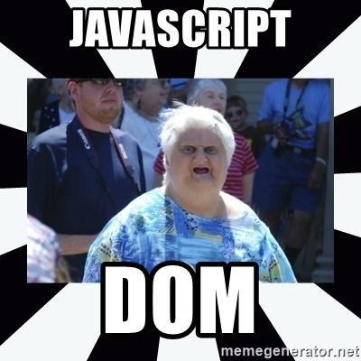
Document Object Model (DOM)

Slide 23
DOM (Document Object Model)
⚡In the DOM, all HTML elements are defined as objects.
⚡The programming interface is the properties and methods of each object.
⚡A property is a value that you can get or set (like changing the content of an HTML element).
⚡A method is an action you can do (like add or deleting an HTML element).
⚡With the HTML DOM, JavaScript can access and change all the elements of an HTML document.
⚡When web page is loaded, browser creates a Document Object Model of the page

Slide 24
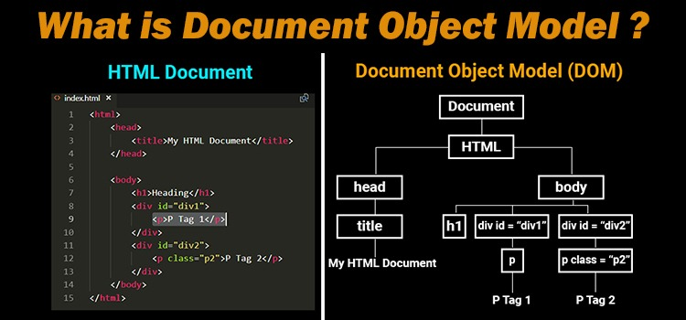
DOM (Document Object Model)

Slide 25
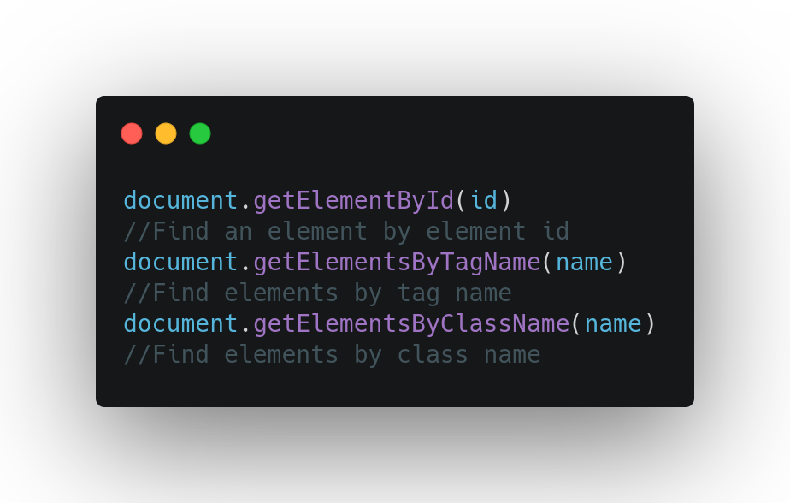
Finding HTML Elements
⚡If you want to access any element in an HTML page, you always start with accessing the document object.
⚡Elements can be found by their "ID", "Tag Name", "Class Name”.

Slide 26
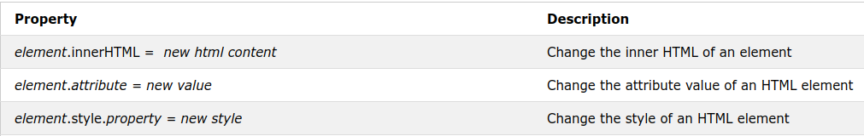
Changing HTML and CSS
⚡The easiest way to modify the content of an HTML element is by using the innerHTML property.
⚡To change the value of an HTML attribute, use this syntax: document.getElementById(id).attribute = new value
⚡To change the style of an HTML element, use syntax: document.getElementById(id).style.property = new style

Slide 27
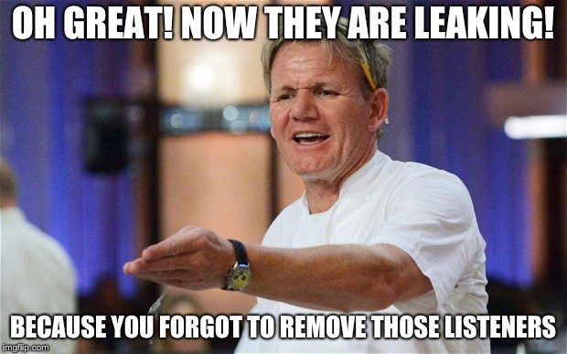
DOM Events
⚡The HTML DOM allows you to execute code when an event occurs.
⚡Events are generated by the browser when "things happen" to HTML elements:
⚡When a user clicks the mouse
⚡When a web page has loaded
⚡When an image has been loaded
⚡When the mouse moves over an element
⚡When an input field is changed
⚡When an HTML form is submitted
⚡When a user strokes a key

Slide 28
THANKS!
Does anyone have any questions?

